Slide 1

Doubly-Linked List
LA
Node
Node
Node
RA
Notes:
The doubly linked list is a well node data structure where the data are stored in a list of nodes **(click)** each one pointing, not only to the next one, **(click)** but also to the previous one. **(click)** On both ends, we have what we call anchors which are fixed to the left, an the right.

Slide 2
Doubly-Linked List
LA
Node
Node
Node
RA
Node
Notes:
NEXT: ADD
If we now want to add a Node to the list, we make it point to its neighbors and then, change the pointers accordingly.

Slide 3
Adding to a Doubly-Linked List
LA
Node
Node
Node
RA
Node
Notes:
If we now want to add a Node to the list, we make it point to its neighbors and then, change the pointers accordingly.

Slide 4
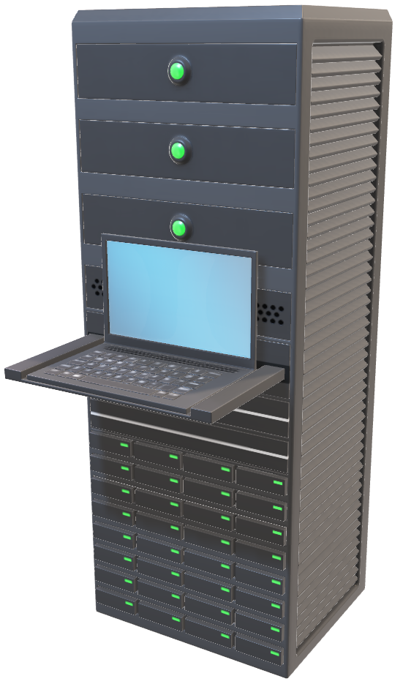
Adding to a Doubly-Linked List
LA
Node
Node
Node
Node
RA
Notes:
NEXT: MULTIPLE THREADS

Slide 5
Adding to a Doubly-Linked List
LA
Node
Node
Node
Node
RA

Slide 6
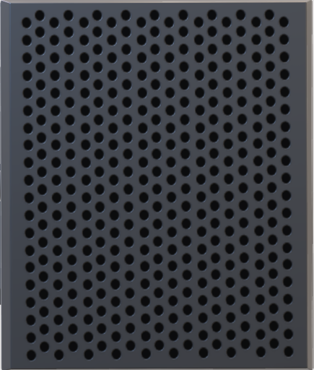



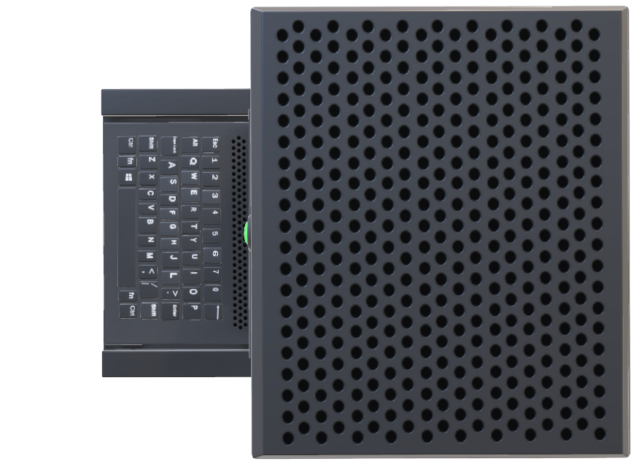

Slide 8
Adding to a Doubly-Linked List
LA
Node
Node
RA
Node
Node
Notes:
If multiple threads want to make modifications to the list,

Slide 9

The hold-and-wait chain
ACQUIRE/LOCK
APPLY
RELEASE/UNLOCK

Slide 10




WAIT FOR LOCK
1.5 m

Slide 11
Built-in Coloring for Highly-Concurrent Doubly-Linked Lists
Hagit Attiya & Eshcar Hillel
Explained by Nicolas van de Walle

Slide 12



Compare And Swap-Chromo

Slide 13

CAS-Chromo
RA
Node
Node
LA
<
<
Node
Node
RA
LA

Slide 14
The operations
PUSH LEFT
PUSH RIGHT
INSERT LEFT
INSERT RIGHT
POP LEFT
POP RIGHT
class Operation {
State state // Init, acquire, apply, release, final
Node subject
Node sourceNode
NodeMemento[3] datasetMemento
int[3] colorSet
}
FRAGILE
FRAGILE
FRAGILE
FRAGILE

Slide 15
The operations
PUSH LEFT
PUSH RIGHT
INSERT LEFT
INSERT RIGHT
POP LEFT
POP RIGHT
class Operation {
State state // Init, acquire, apply, release, final
Node subject
Node sourceNode
NodeMemento[3] datasetMemento
int[3] colorSet
}
INSERT
PUSH
POP
INSERT

Slide 16
<
<
New Node
PUSH LEFT
INIT
LA
Node 1
Node 2
RA
Node1
POP LEFT
INIT

Slide 17
<
<
New Node
PUSH LEFT
INIT
LA
Node 1
Node 2
RA
Node1
POP LEFT
INIT

Slide 18
<
<
New Node
PUSH LEFT
ACQUIRE
LA
Node 1
Node 2
RA
Node1
POP LEFT
INIT

Slide 19
<
<
New Node
PUSH LEFT
ACQUIRE
LA
Node 1
Node 2
RA
Node1
PUSH LEFT
ACQUIRE
POP LEFT
ACQUIRE

Slide 20
<
<
New Node
PUSH LEFT
ACQUIRE
LA
Node 1
Node 2
RA
Node1
PUSH LEFT
ACQUIRE
POP LEFT
ACQUIRE

Slide 21
<
<
New Node
PUSH LEFT
ACQUIRE
LA
Node 1
Node 2
RA
Node1
PUSH LEFT
ACQUIRE
POP LEFT
ACQUIRE

Slide 22
<
<
New Node
PUSH LEFT
APPLY
LA
Node 1
Node 2
RA
Node1
PUSH LEFT
APPLY
POP LEFT
ACQUIRE

Slide 23
<
<
New Node
PUSH LEFT
APPLY
LA
Node 1
Node 2
RA
Node1
PUSH LEFT
APPLY
POP LEFT
ACQUIRE

Slide 24
<
<
New Node
PUSH LEFT
APPLY
LA
Node 1
Node 2
RA
Node1
PUSH LEFT
APPLY
POP LEFT
ACQUIRE

Slide 25
<
<
PUSH LEFT
APPLY
LA
New Node
Node 1
Node 2
RA
Node1
PUSH LEFT
APPLY
POP LEFT
ACQUIRE

Slide 26
<
<
PUSH LEFT
RELEASE
LA
New Node
Node 1
Node 2
RA
Node1
PUSH LEFT
RELEASE
POP LEFT
ACQUIRE

Slide 27
<
<
PUSH LEFT
FINAL
LA
New Node
Node 1
Node 2
RA
Node1
PUSH LEFT
FINAL
POP LEFT
ACQUIRE

Slide 28

<
<
LA
New Node
Node 1
Node 2
RA
Node1
POP LEFT
ACQUIRE

Slide 29
<
<
LA
New Node
Node 1
Node 2
RA
Node1
POP LEFT
RELEASE .

Slide 30
<
<
LA
New Node
Node 1
Node 2
RA
Node1
POP LEFT
FINAL .

Slide 31
<
<
LA
New Node
Node 1
Node 2
RA
Node1
POP LEFT
INIT

Slide 32
<
<
LA
New Node
Node 1
Node 2
RA
Node1
POP LEFT
ACQUIRE

Slide 33
<
<
LA
New Node
Node 1
Node 2
RA
Node1
POP LEFT
APPLY

Slide 34
<
<
LA
New Node
Node 1
Node 2
RA
Node1
POP LEFT
APPLY

Slide 35
<
<
LA
Node 1
Node 2
RA
New Node
Node1
POP LEFT
APPLY

Slide 36
<
<
LA
Node 1
Node 2
RA
New Node
Node1
POP LEFT
APPLY

Slide 37
<
<
LA
Node 1
Node 2
RA
New Node
Node1
POP LEFT
APPLY

Slide 38
<
<
LA
Node 1
Node 2
RA
New Node
Node1
POP LEFT
RELEASE

Slide 39
<
<
LA
Node 1
Node 2
RA
New Node
Node1
POP LEFT
FINAL

Slide 40



<
<
CAS-Chromo
LA
Node 1
Node 2
RA
ACQUISITION
POP LEFT
FINAL
New Node
Node1

Slide 41
CAS-Chromo
ACQUISITION

Slide 42

Third Party Resources
Icon made by Freepik
From www.flaticon.com
https://www.flaticon.com/free-icon/anchor_619118
Every other media has been home made
Icon made by Freepik
From www.flaticon.com (with custom changes)
https://www.flaticon.com/free-icon/laptop_689355
Icon made by Freepik
From www.flaticon.com (with custom changes)
https://www.flaticon.com/free-icon/paint-bucket_479311
Icon made by Freepik
From www.flaticon.com
https://www.flaticon.com/free-icon/help_2597143
Icon made by Freepik
From www.flaticon.com
https://www.flaticon.com/free-icon/road-work_497720
Icon made by Freepik
From www.flaticon.com (with custom changes)
https://www.flaticon.com/free-icon/paint-palette_603541

